Slide 1
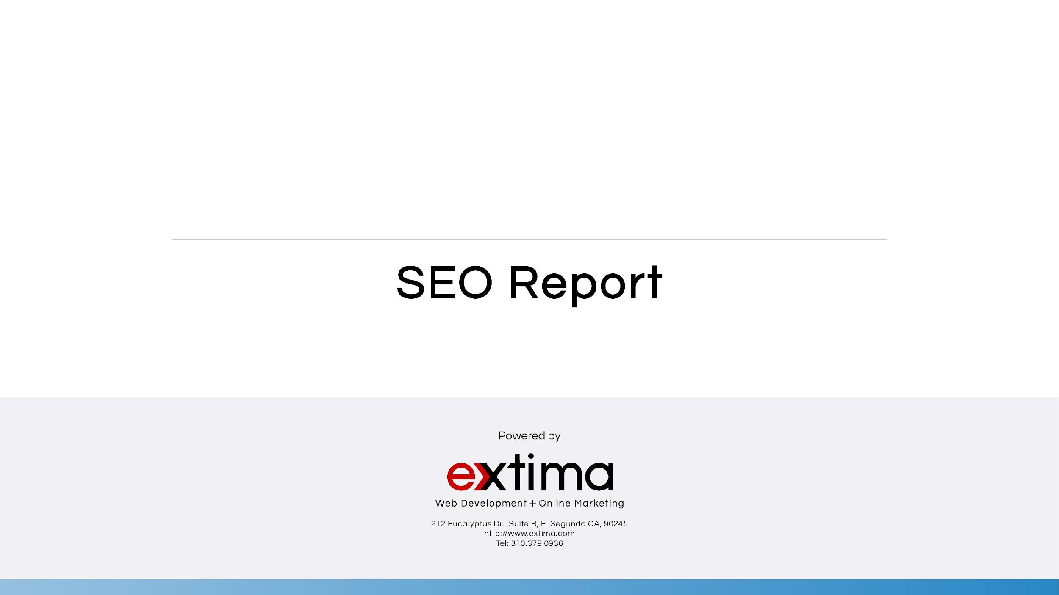

August 2019

Slide 2
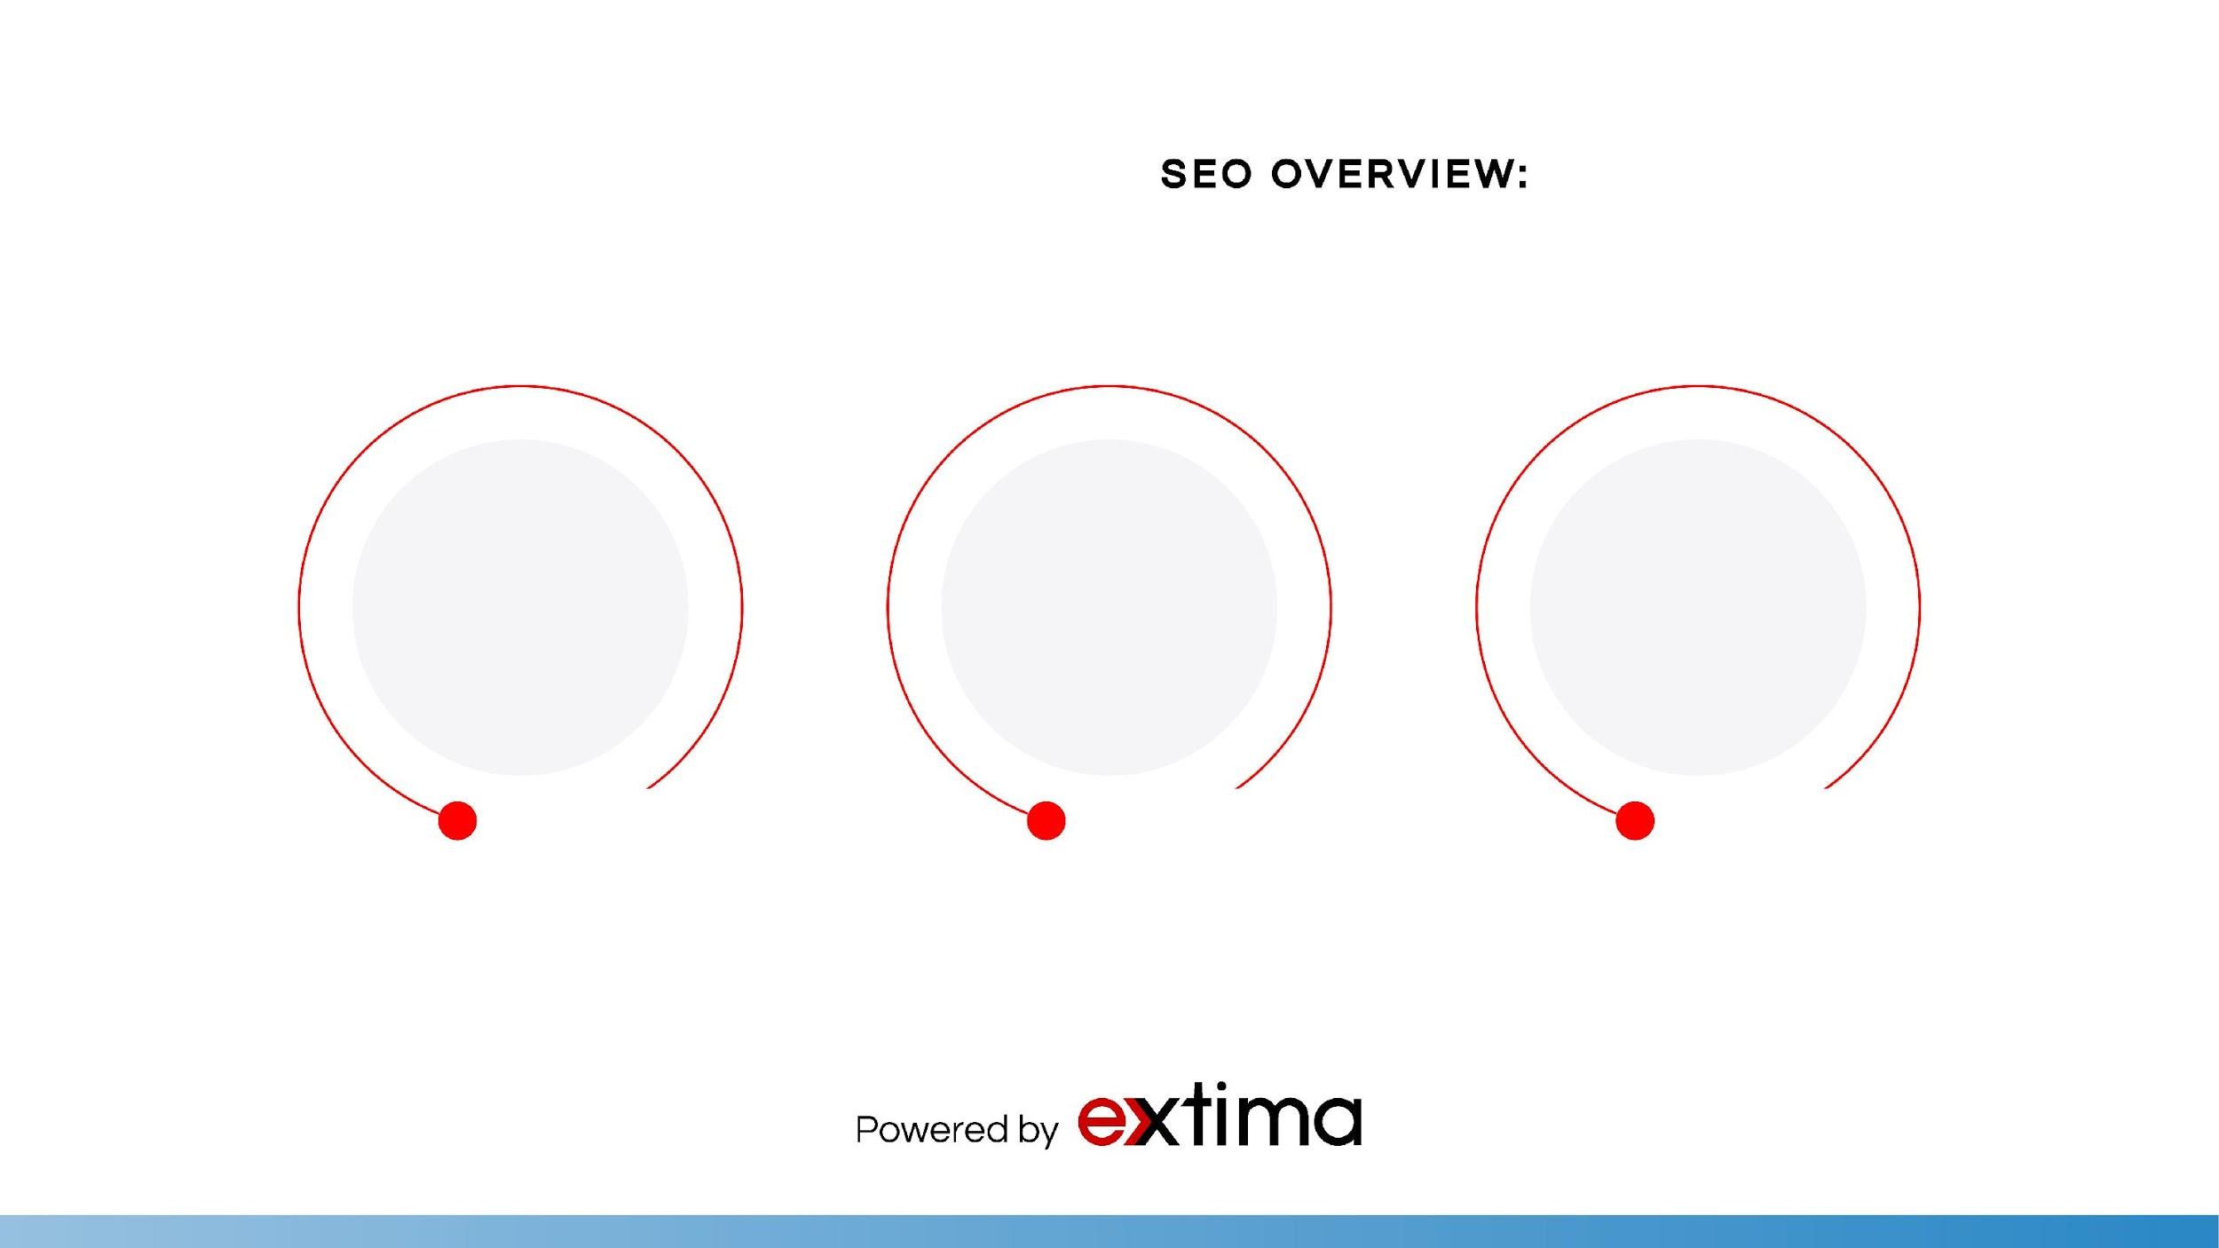
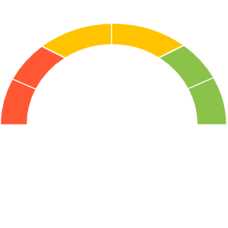
1,399
GOOD
2,830
1,612
Number of sessions to your webpage
Number of pageviews to your website
Number of users to your website

Slide 3
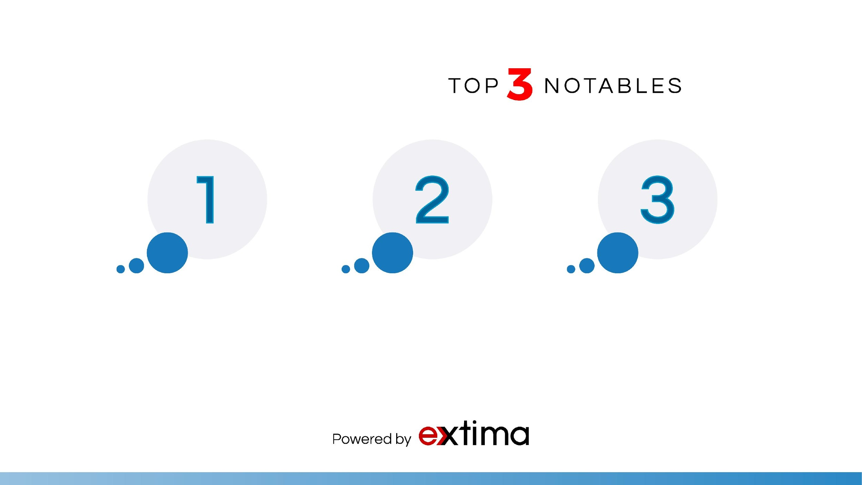



The keyword “printed shrink film” is now ranking as the fourth result on Google
Paid search traffic increased by +30%
17.63% of the Pay-Per-Click (or PPC) traffic comes from “Labels and Shrink Sleeves” campaign. This campaign performs better than the others.

Slide 4
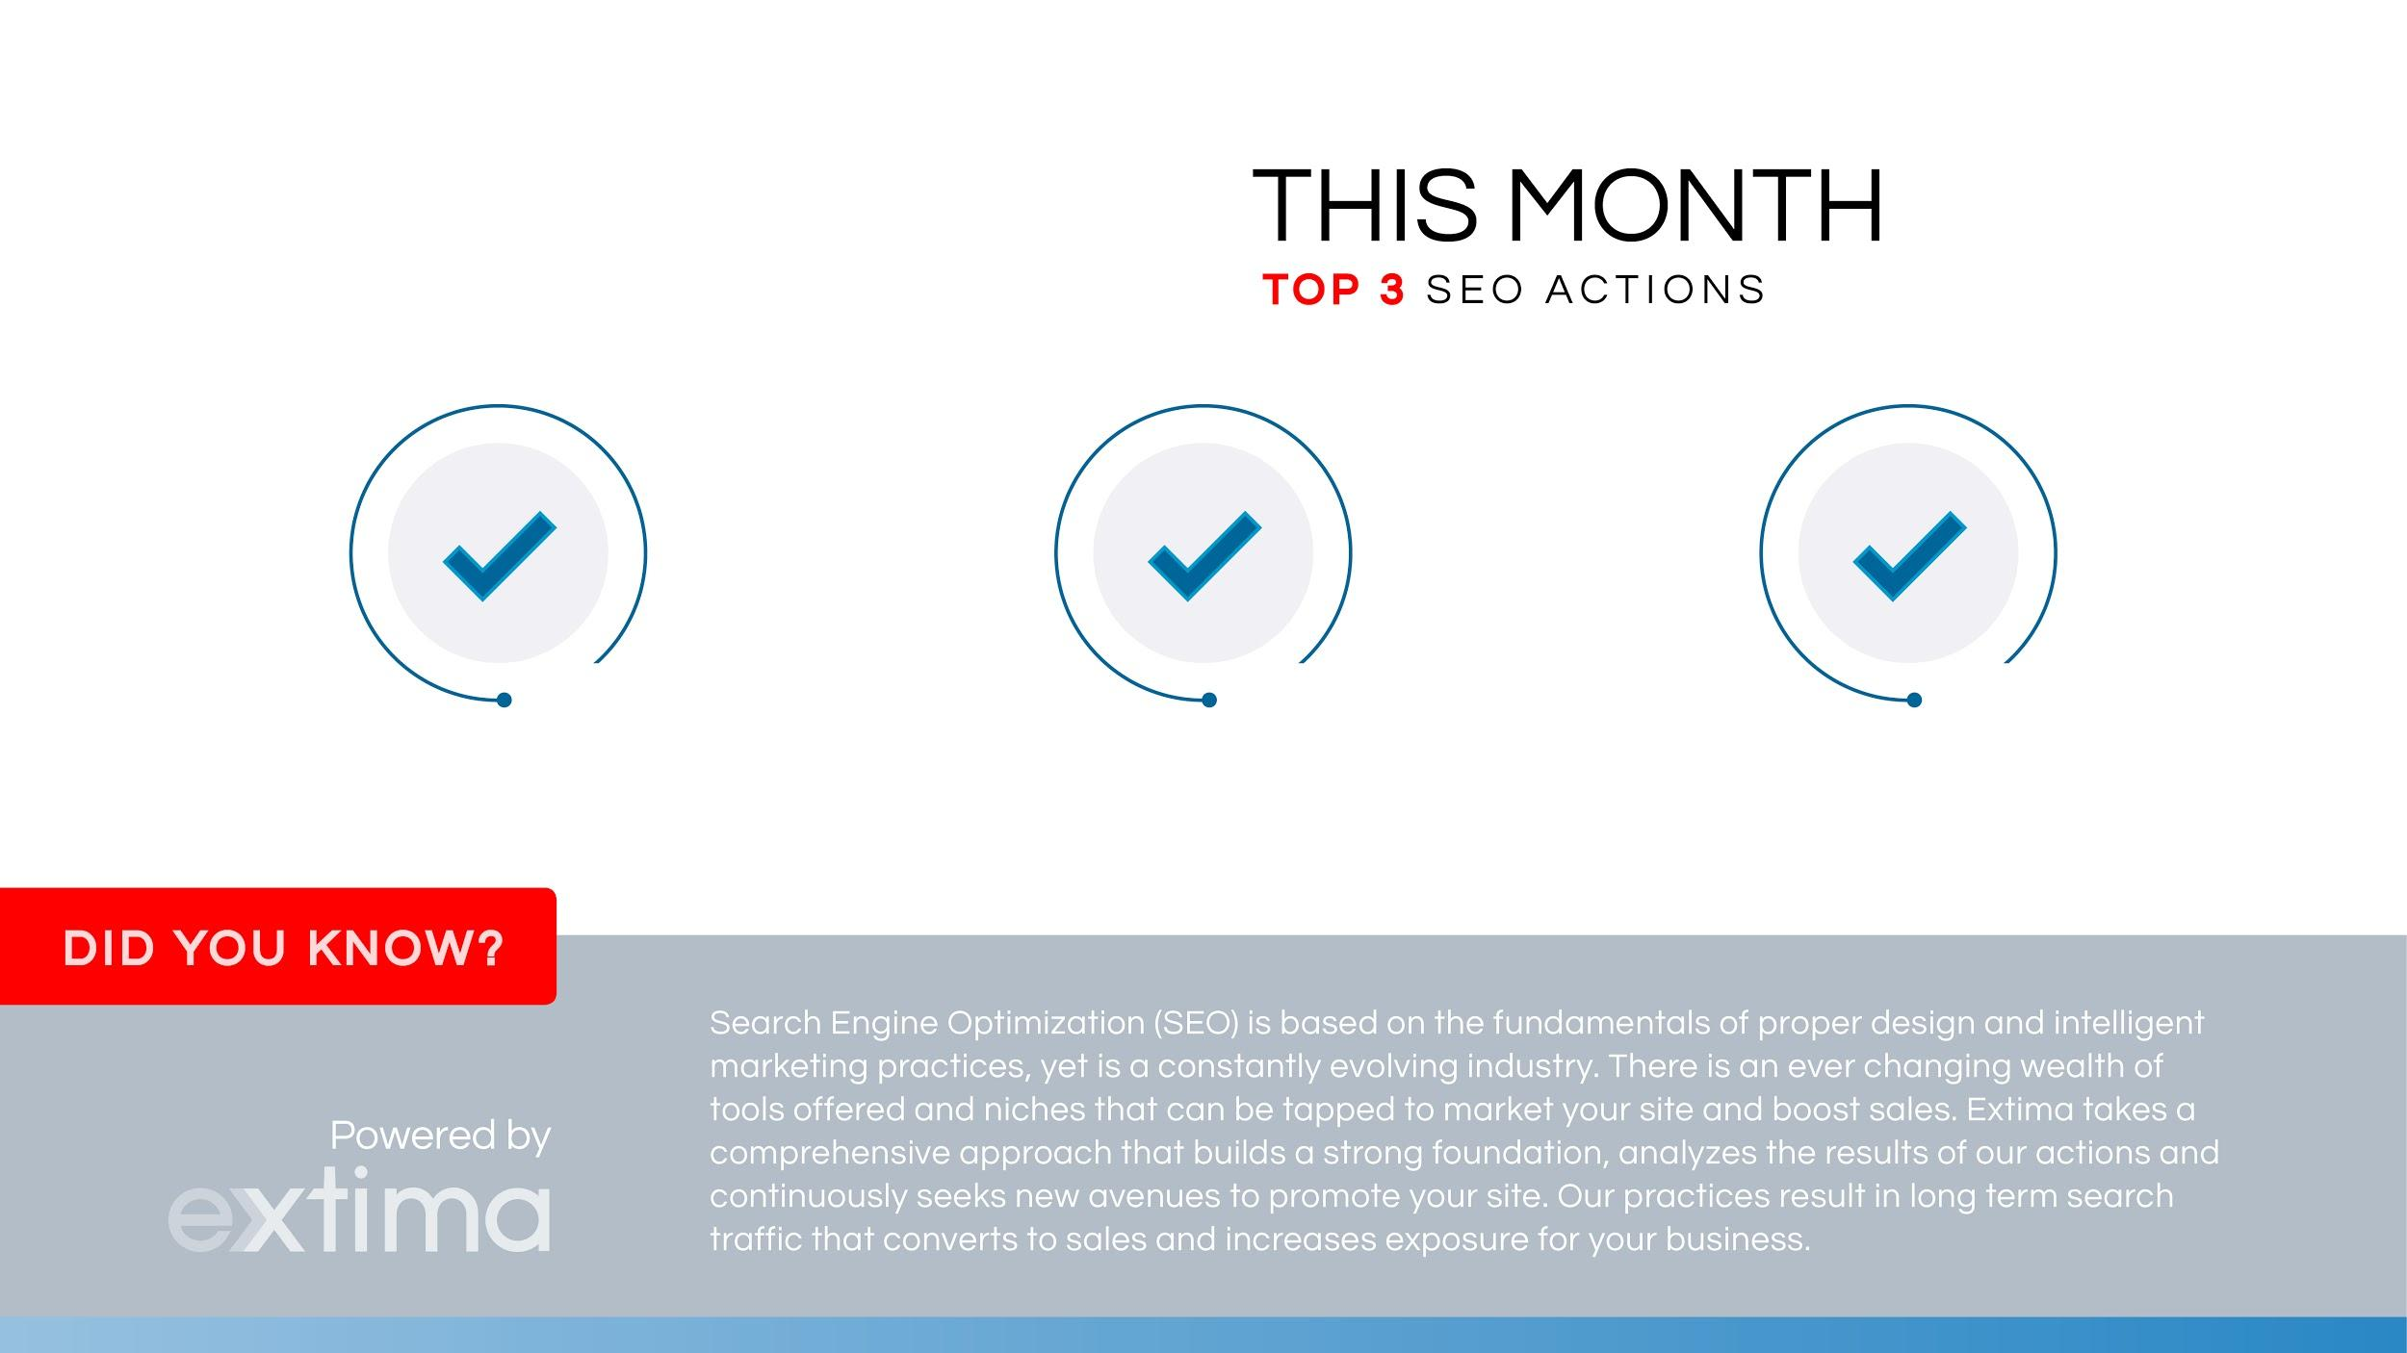
Comprehensive Keyword Research & Analysis (x5)
In-Depth Competitor Audit & Analysis (x2)
On-Page Technical SEO Audit and Analysis (x3)

Slide 5
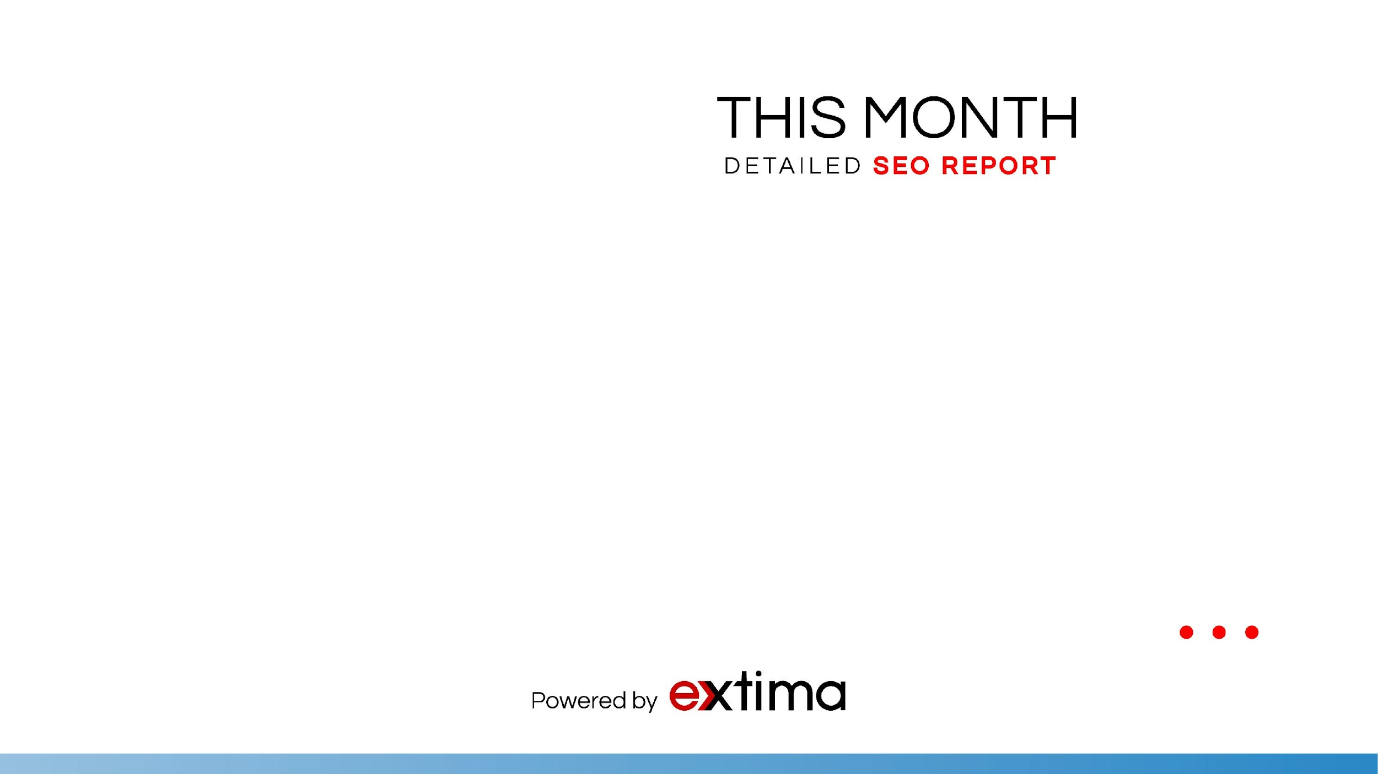
Overall traffic was good this month. Overall sessions increased by +14%.
Google announced via Twitter that they are releasing a mobile-compatibility algorithm update that ranks websites with responsive, strategically designed content higher on search engine result pages (SERPs). This is because this type of content is more user-friendly, which is what Google appreciates as their goal is to make their user experience, especially for those using mobile devices, as accurate and effective as possible.
Therefore, we have begun necessary steps to analyze where to further optimize your site for mobile, as this may be required due to these new updates. We are running mobile-compliance, site-compliance, site speed, schema markup and structured data tests on your core and other pages. Through Extima’s efforts, we hope to see an increase in keyword rankings and search queries on search engine result pages (SERPs). As always, we submitted links in the Google Search Console (formerly Webmaster Tools) to help ensure that the search engines were indexing the URLs properly.

Slide 6

Next month, we will determine which strategic keywords to further target in your website’s content, and work to update meta content to both engage users and provide search engines with required keywords. As always, our SEO team must continue to optimize core and other high-traffic landing pages with organic keywords that affect your business and critical online marketing optimizations. We will also follow changes in trends to your keywords and analyze effects of the latest Google Algorithm update.
Next month we will also continue to optimize “packaging” industry related keywords on to your top 3 landing, core and product pages. The goal is to gain as many organic keywords related to the “packaging” industry as possible. We will also work towards implementing these pages into the campaign, as these will have more page authority than the products pages. Page Authority is a score (on a 100-point scale) that predicts how well a specific page will rank on search engines. It is based off data from the global web indexes, link counts and dozens of other factors. We hope to increase your page and domain rank as the SEO campaign continues.
We will also continue to build local links to ensure a solid web presence and more exposure. Local links help boost your local search rankings, improve your domain authority, and ultimately, send you valuable traffic. As always, we will continue monitoring site activity and Google Search Console for website errors.

Slide 7
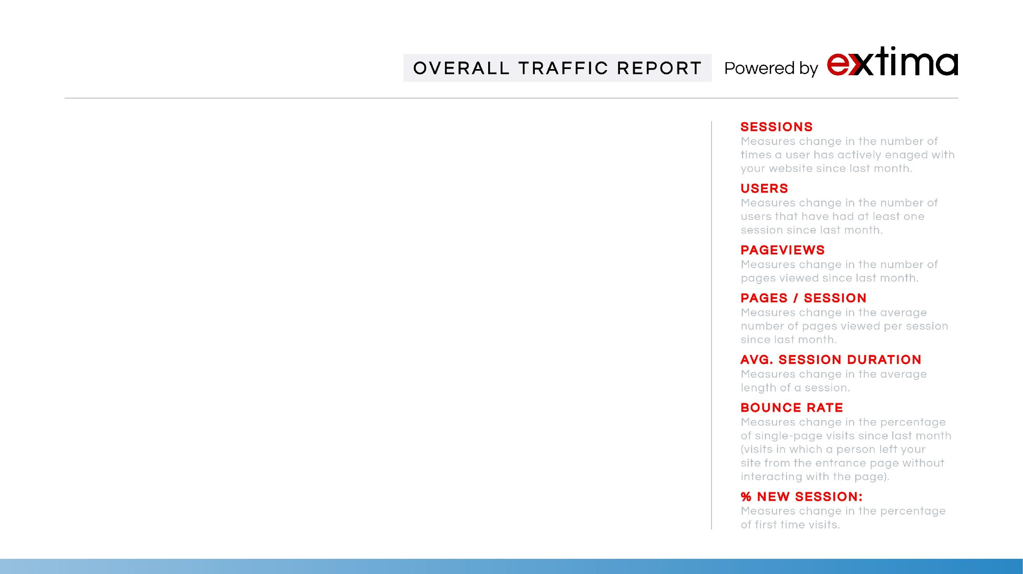
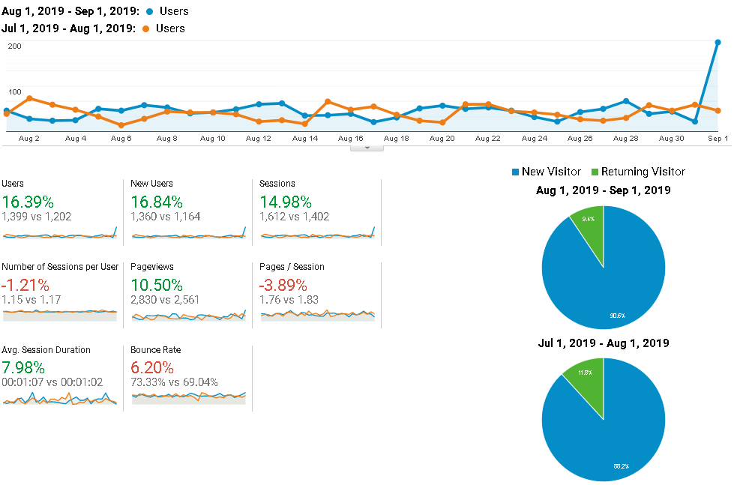

Slide 8
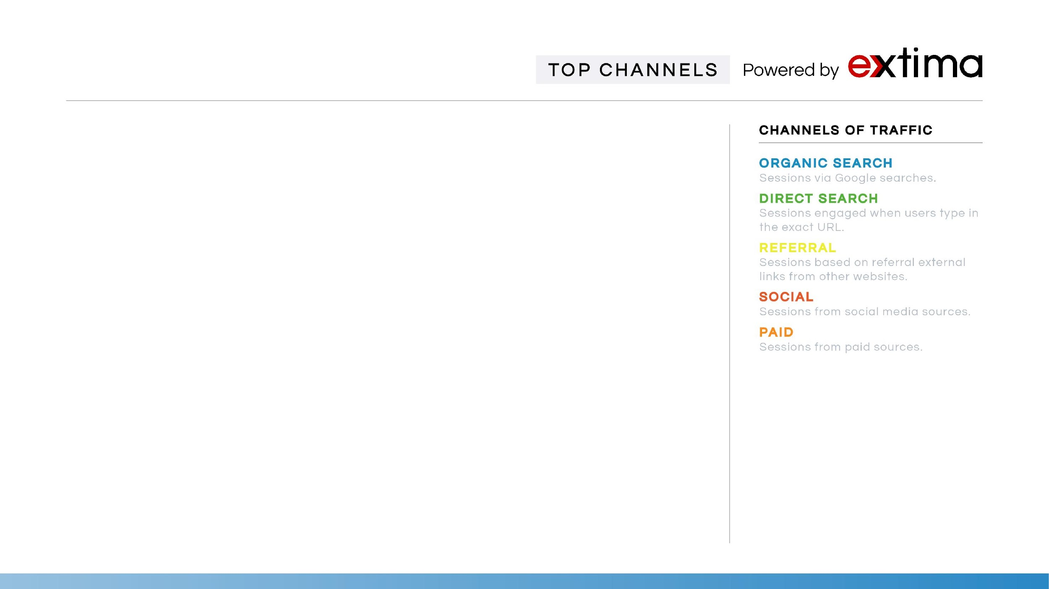
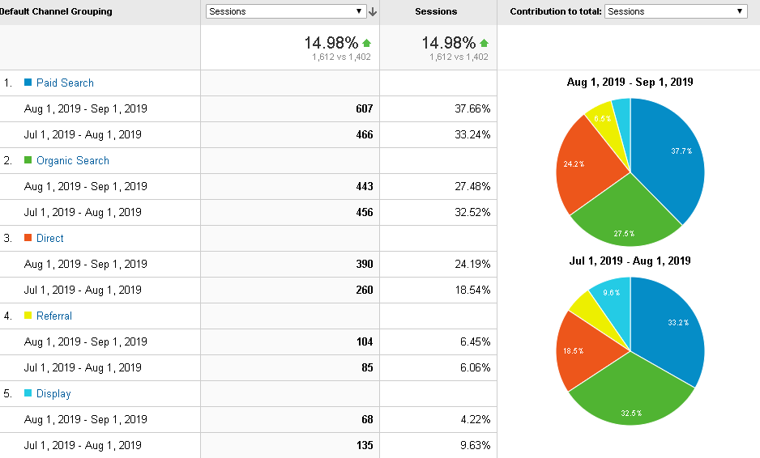

Slide 9

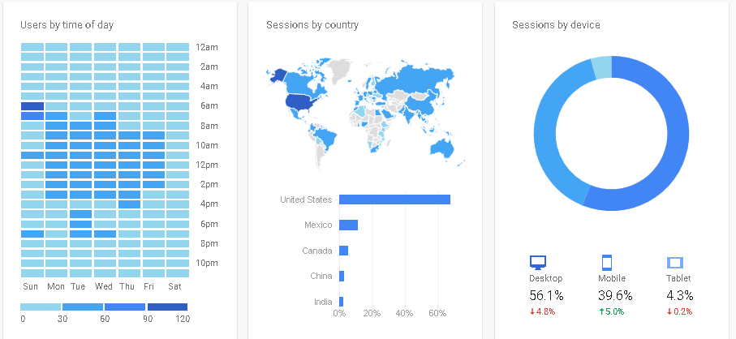
OVERALL USER REPORT
When do your users visit?
Where are your users?
What are your top devices?
Why Know Your Users?
To understand the users visiting the website, you first need to know:
When do they visit the site
Where are they located in the world.
What are their devices of choice when visiting your site.
There’s a lot of data available in your SEO Report that will help you build knowledge of who’s visiting your website.
The more you know about your users, the more informed your decisions can be.

Slide 10
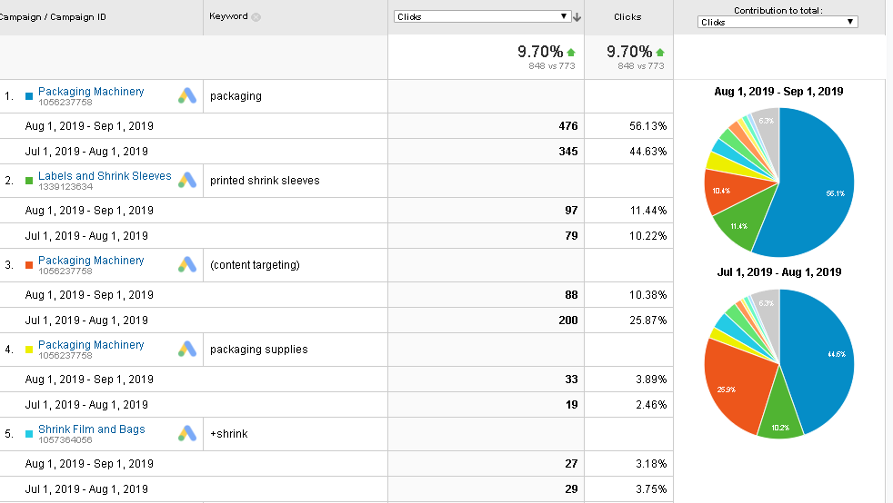
AdWords Performance
Google AdWords
Here is a look at your Google AdWords traffic for this last month.
Google AdWords is an online advertising service developed by Google, where advertisers pay to display brief advertising copy, product listings, and video content within the Google ad network to web users.
Success depends on:
- Competitiveness of keywords
- Bidding strategies
- High-quality conversions
- Other industry exclusive factors
For the most part, we've found that Google AdWords is extremely effective for many kinds of businesses, as long as they don't waste their money on the wrong keywords, or write weak, low CTR ads.

Slide 11
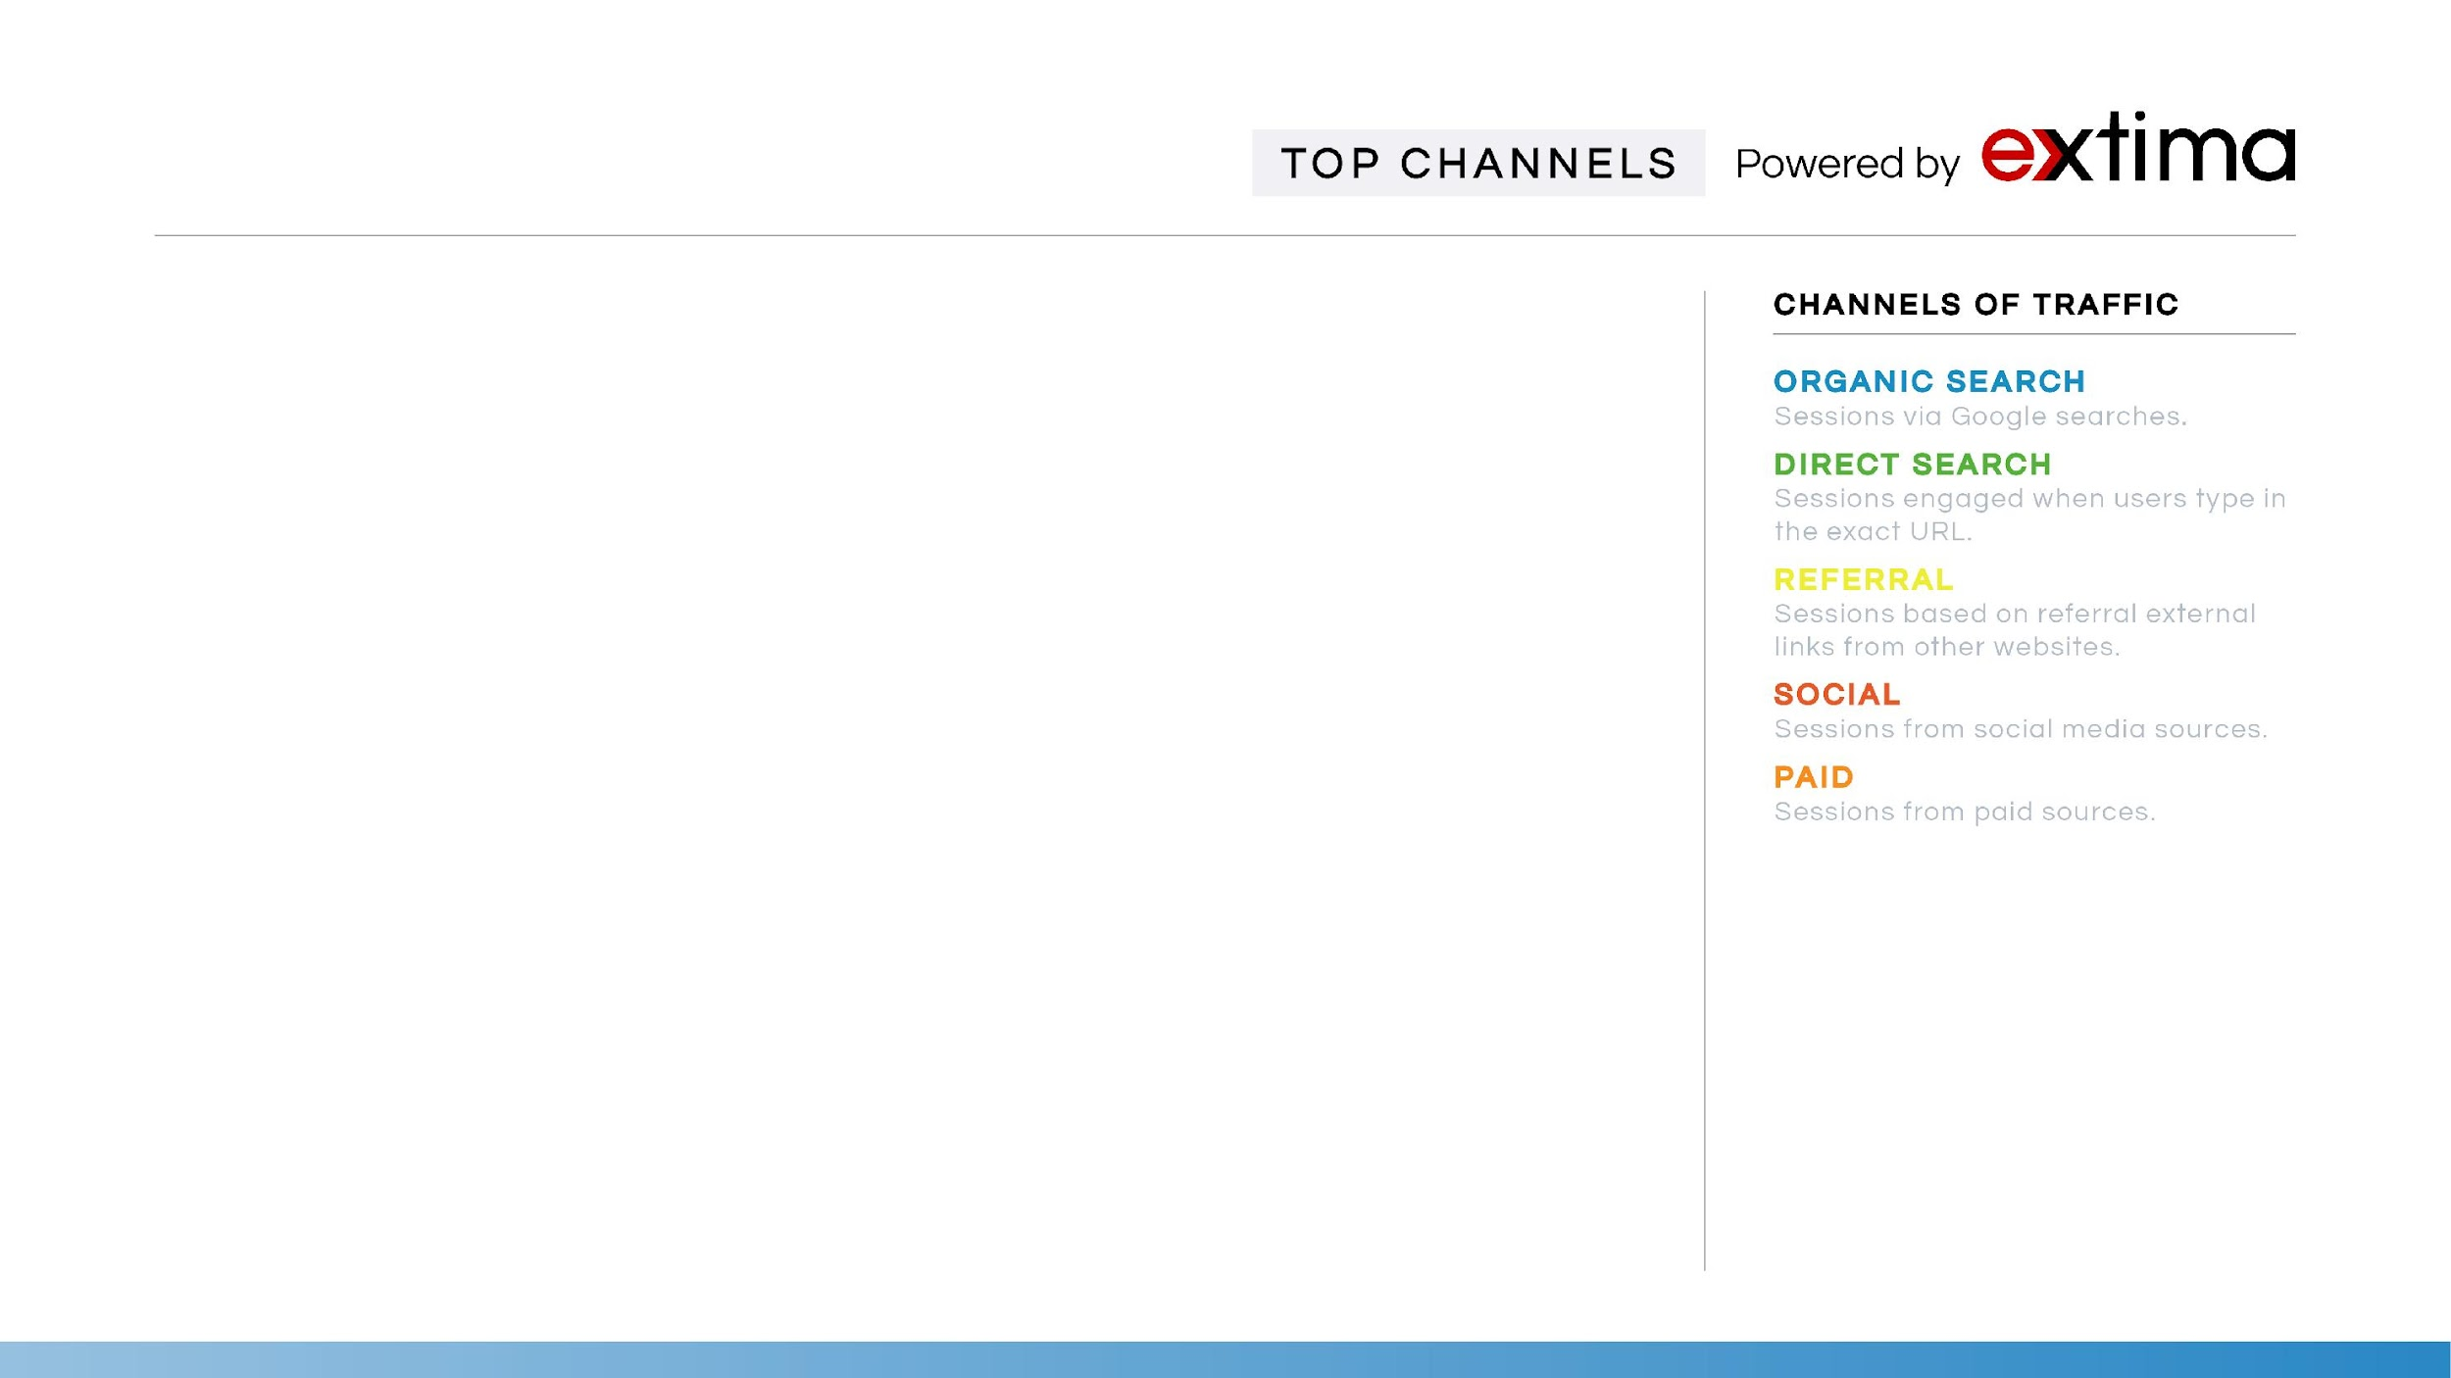
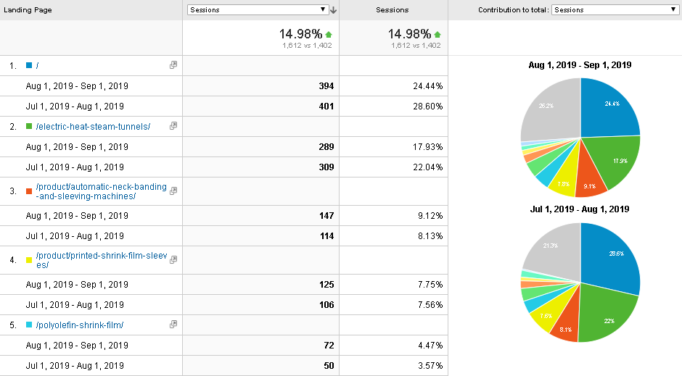
TOP LANDING PAGES

Slide 12
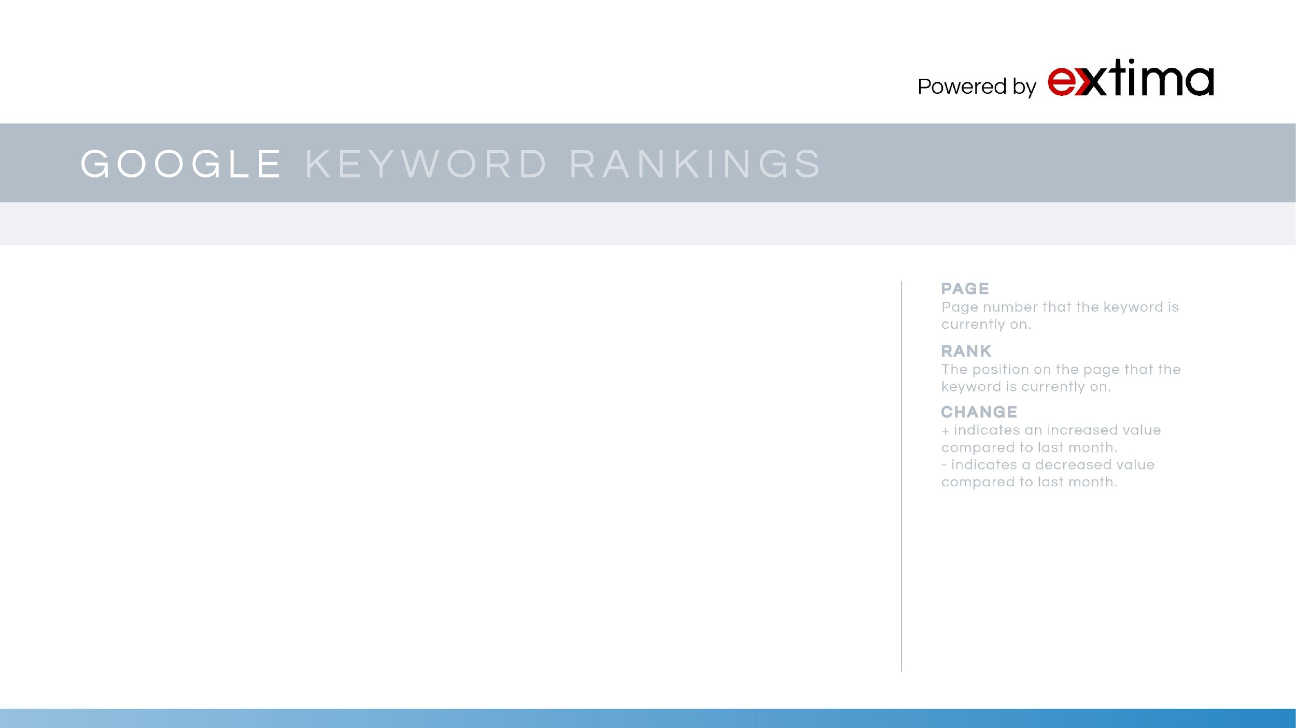
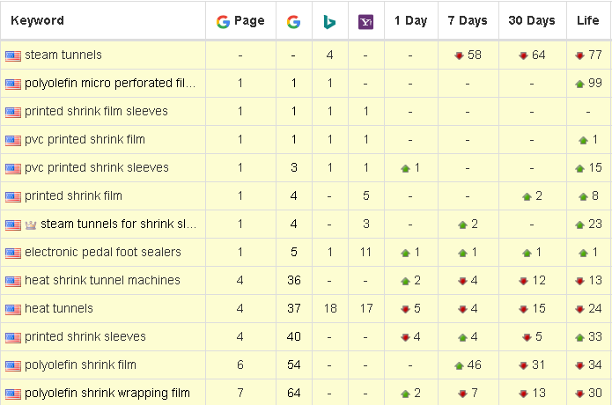
GOOGLE & BING KEYWORD RANKINGS

Slide 13
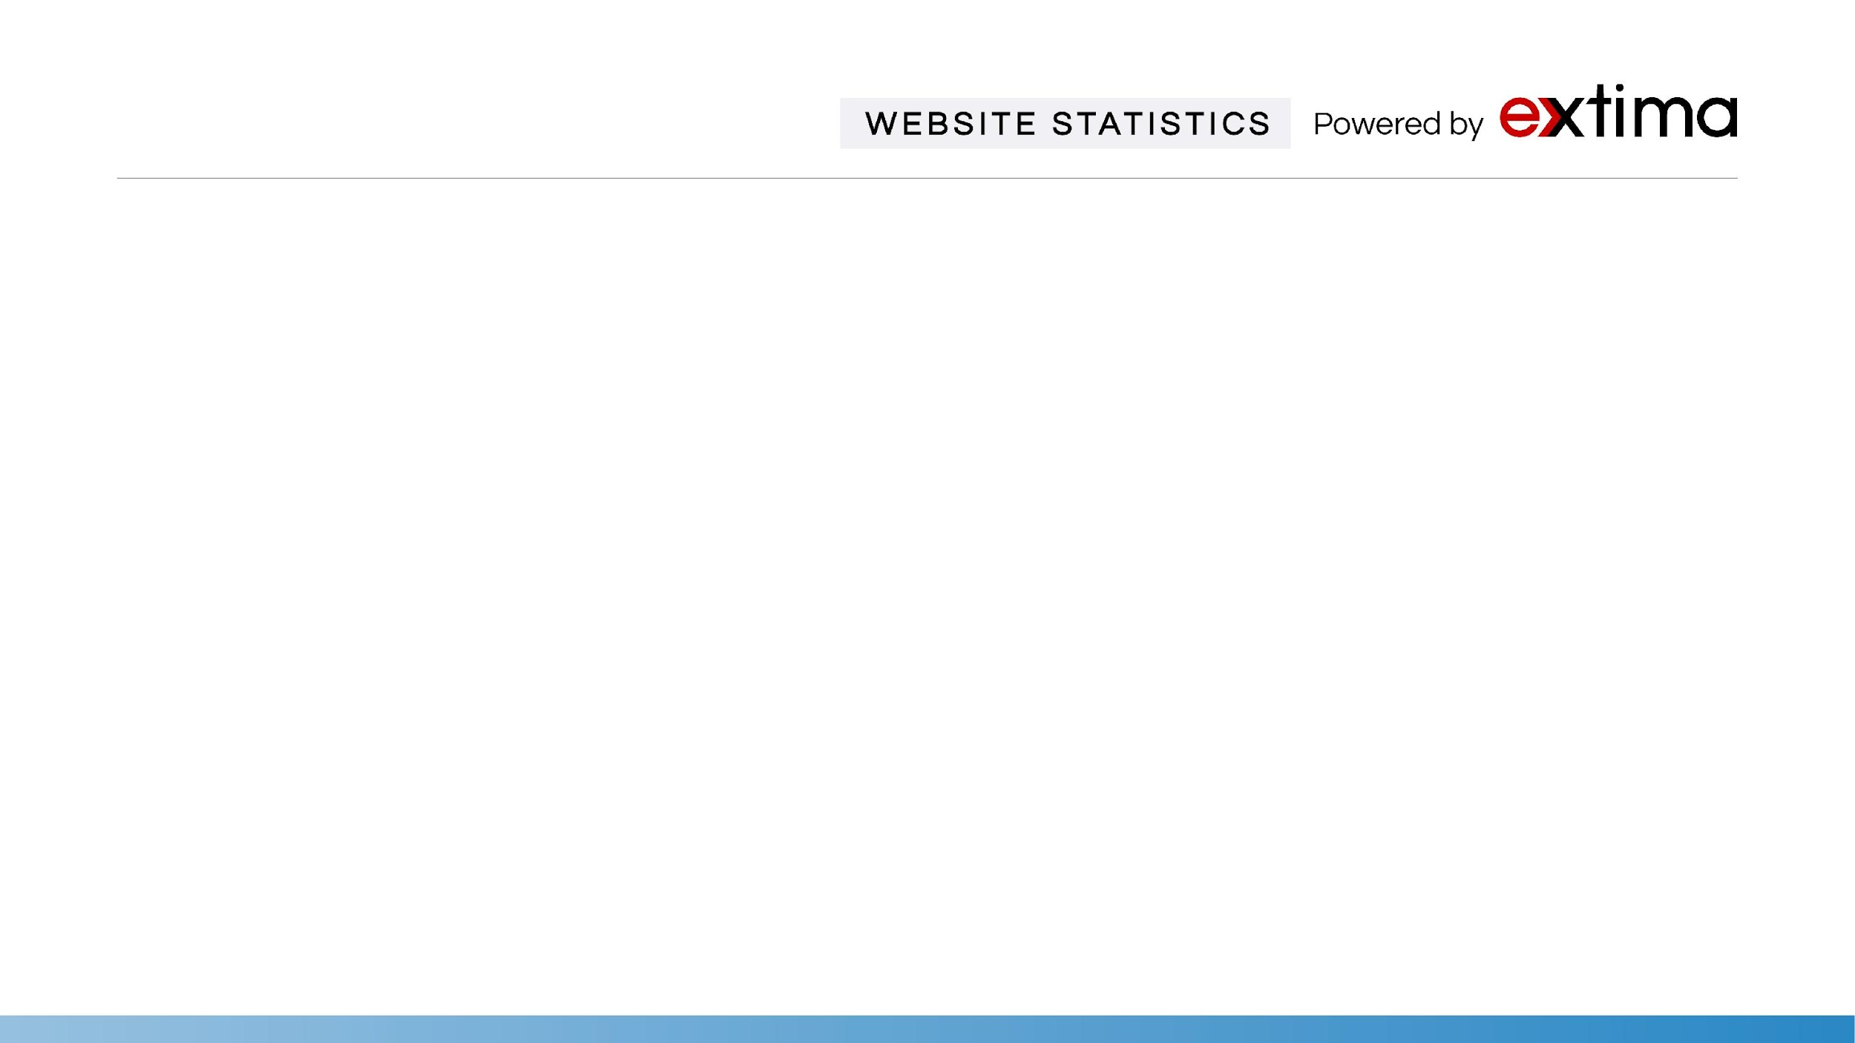
Statistics | June | July | Aug | Comments
Google Index | 272 | 298 | 332 | Google Index is the number of links currently indexed in Google’s database.
Marketing Grade | 85% | 82% | 82% | Market Grader uses a blend of different variables, including site performance, Mobile design, SEO, and Security.
Domain Rank | 19/100 | 18/100 | 18/100 | Domain Rank shows how strong a backlink profile is relative to your whole site.
Ranking Keywords | 62 | 60 | 209 | Number of Keywords for which this site ranks within the top 50 positions on Google.
Linking Root Domains | 190 | 173 | 173 | Total number of websites linking back to your website.
Total Links | 1.2k | 1k | 1k | Total number of links driving traffic to your site. We will continue a campaign to aggressively acquire more links.
Alexa Rank | 3.23M | 6.17M | 5.53M | Alexa measures relative traffic levels. A low rank suggests high traffic levels and an important website.

Slide 14
